Slide 1


HACK MACHINE
NO BROKER

Slide 2
TEAM MEMBERS
Deepesh Sherwal
Utkarsh Harit
Yasmeen Parveen
Mohit Saini
Umang Mittal
Praveen Kumawat

Slide 3
NO BROKER
Problem statement-
Design a machine learning algorithm to predict the rent of a property.
You will have following days available
100,000 property data from a particular City. Will have around 50 attributes of the property
Data of the neighborhood of these properties
You are free to source more data as needed.
Given a new property your algorithm should be able to predict a rent range of the property.

Slide 4

IDEA
If you are looking for a house on rent and running door to door for this. So here is the solution for your problem – “NO BROKER”.
So, we have designed a machine learning model to predict the house rents for cheaper prices.

Slide 5

MATERIALS/MODELS WE HAVE USED
Visualization tool
Anaconda(Spyder)
Adobe Aftereffects
Brackets(for front end)
Random Forest Regression Model

Slide 6


DESIGN PROCESS
Problem analysis
Data collection
Data preprocessing
Data visualization
Manipulating into machine learning model

Slide 7
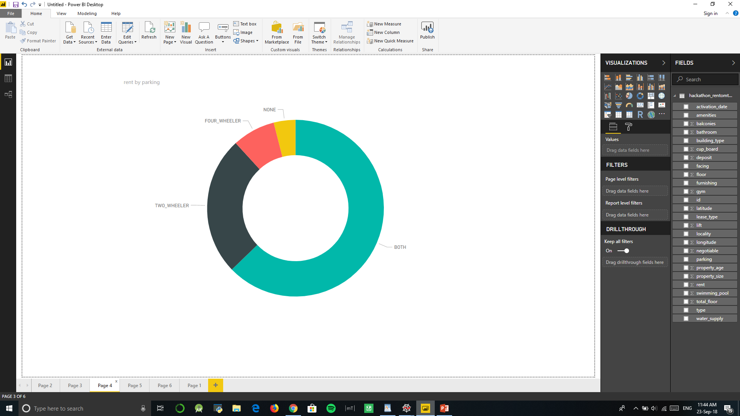

Slide 8
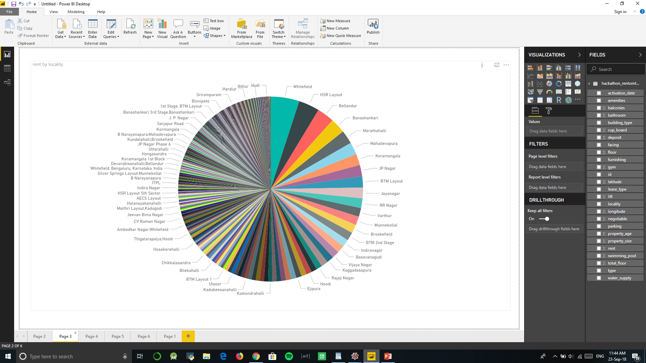

Slide 9
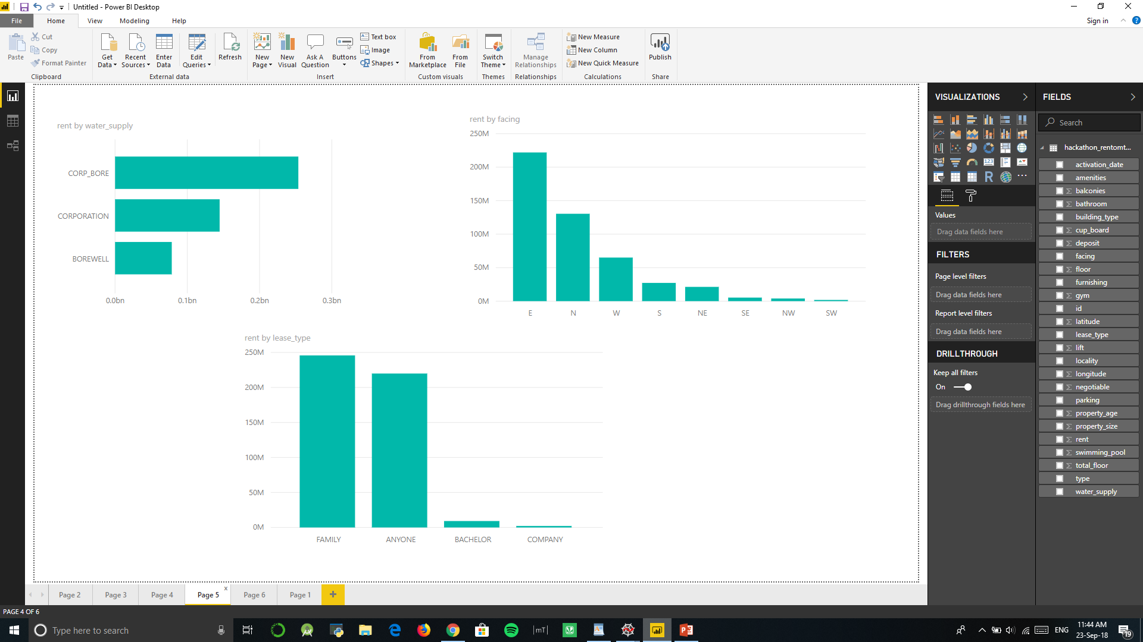

Slide 10
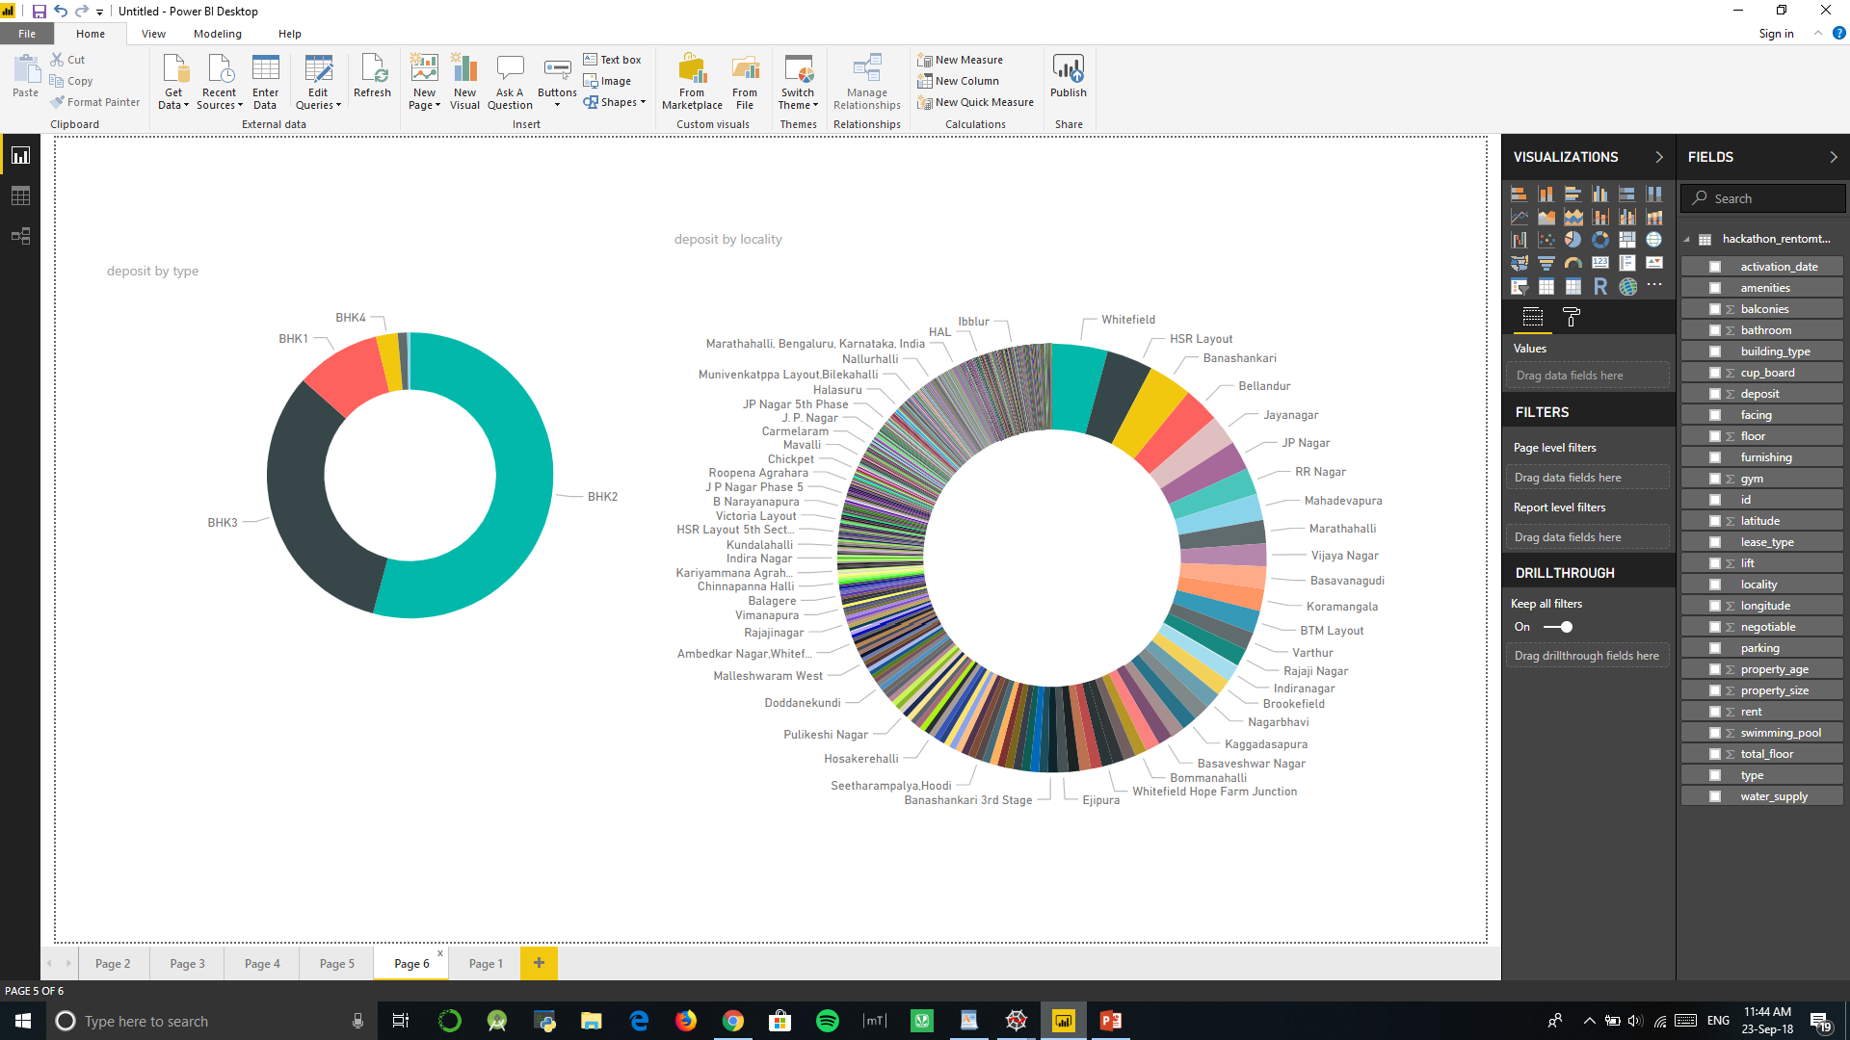

Slide 11
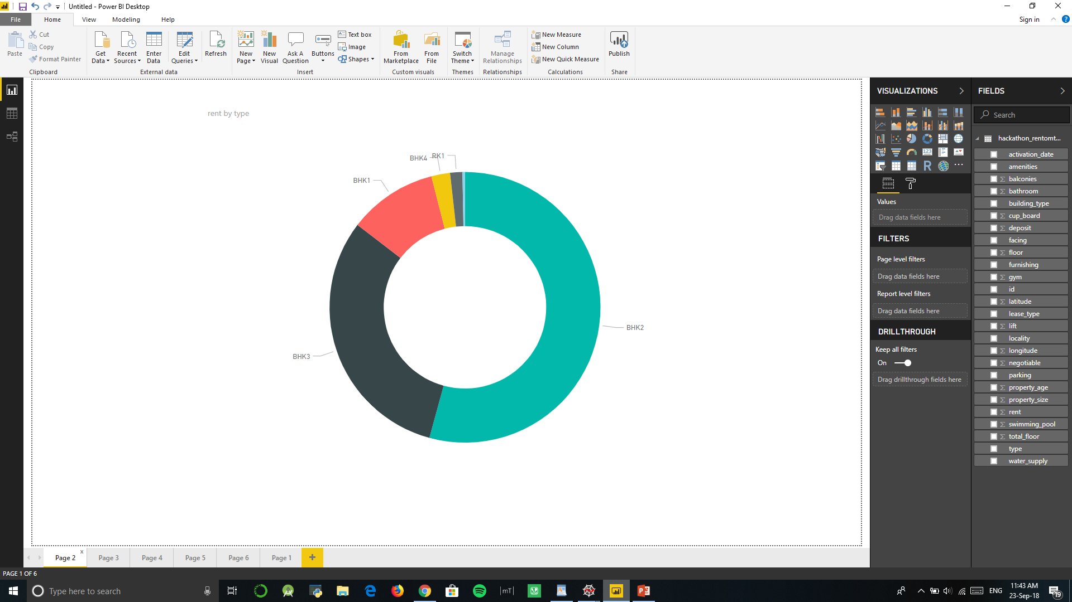
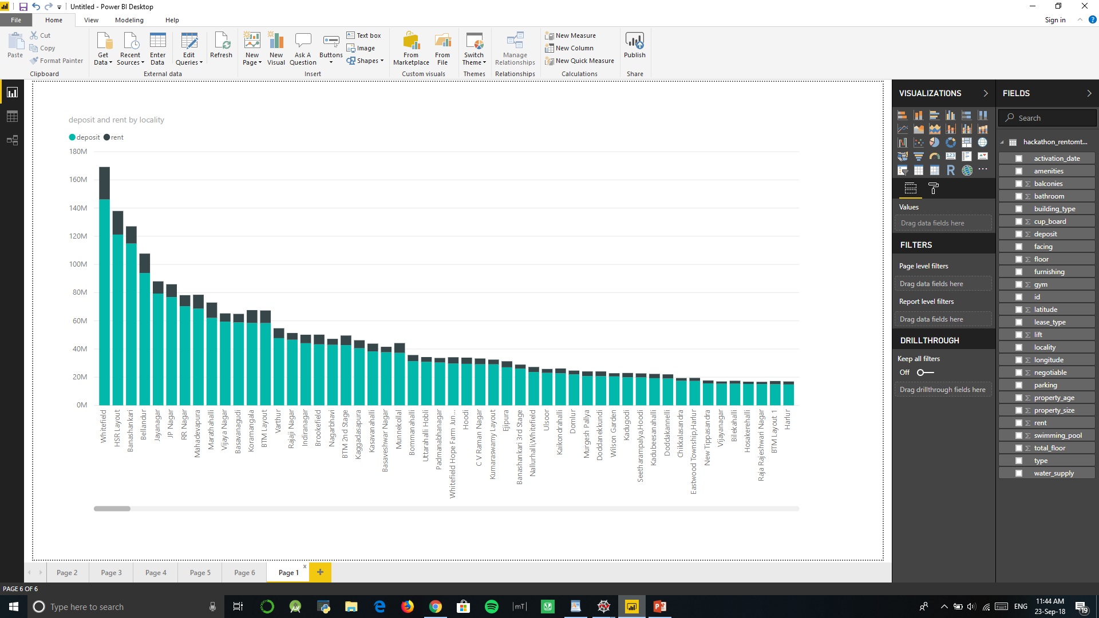
REFERENCES
bit.ly/rtuhack (for data set)
Pandas documentation
ML documentationw

Slide 12
THANK YOU

